Slide 1



UNIT 1;
All too human
Lesson 6; Moving away

Slide 2
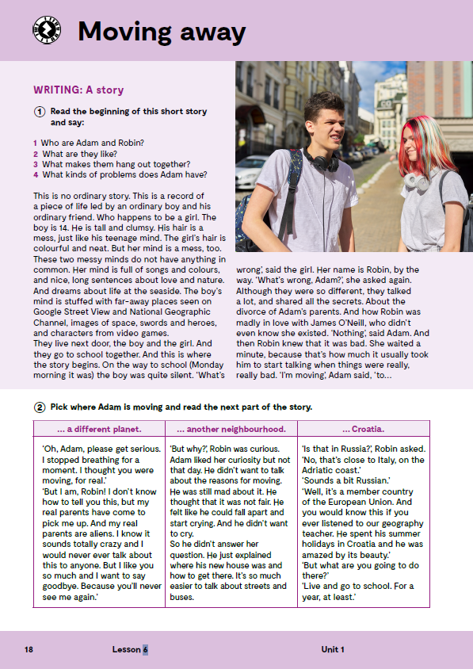
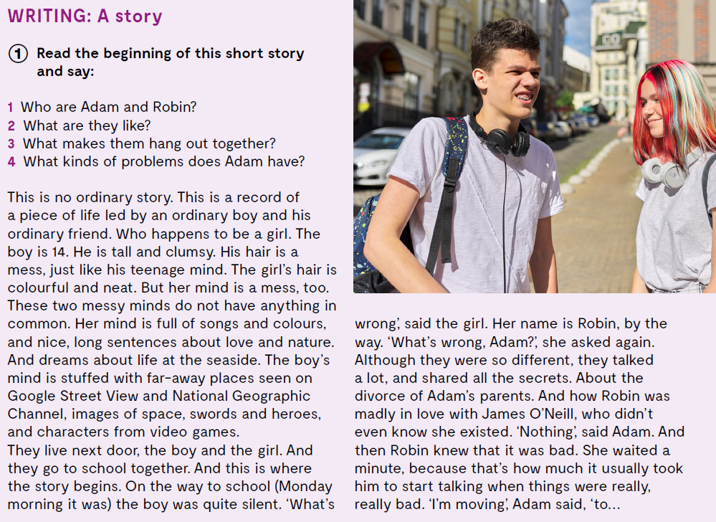
Read the beginning of this short story and say:
Who are Adam and Robin?
What are they like?
What makes them hang out together?
What kinds of problems does Adam have?
mess
stuffed with
far-away places
brainstorm
outline
draft
neat
to have in common
to fall apart
nered
napunjen sa
daleka mjesta
oluja ideja
obris
nacrt
uredno
imati zajedničko
raspasti se

Slide 3
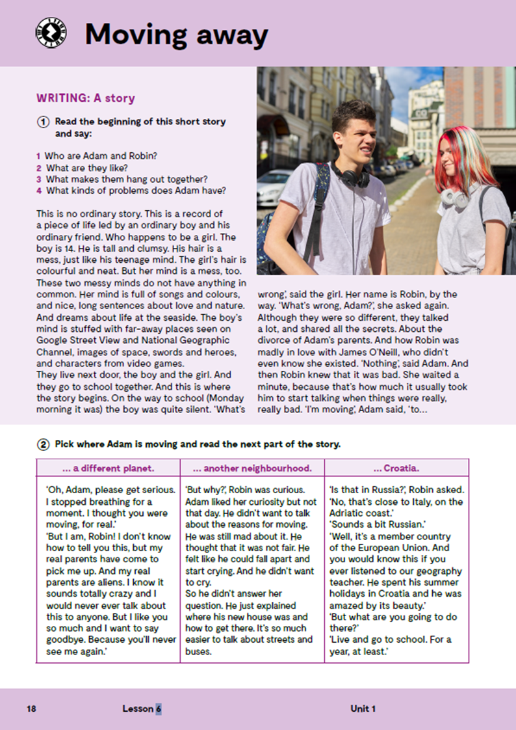
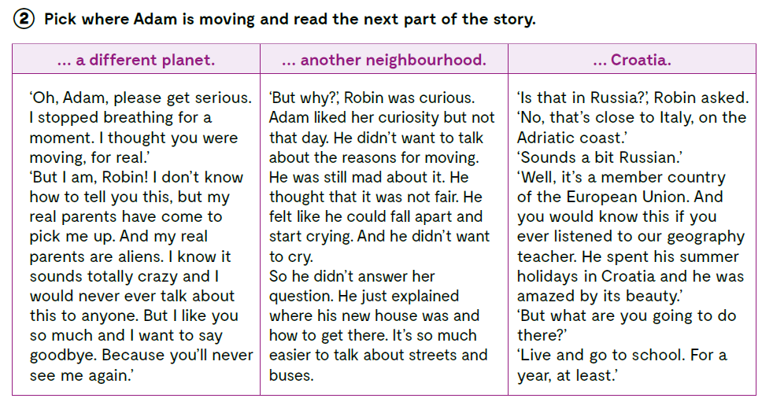

Slide 4
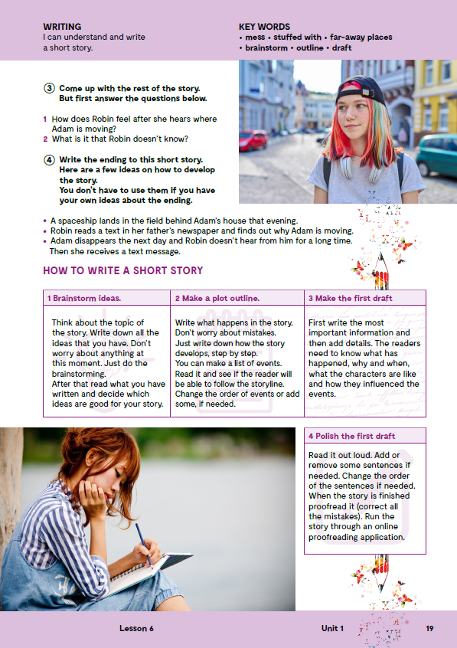
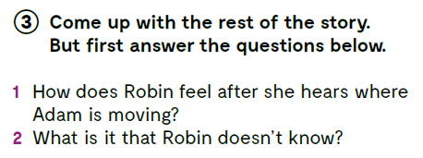
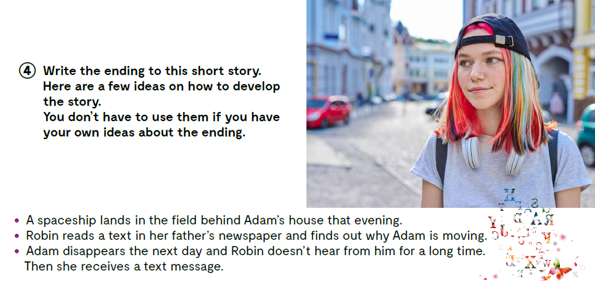
On the next page, page 19.
How does Robin feel after she hears where Adam is moving?
What is it that Robin doesn’t know?
Come up with the rest of the story.
Write the ending to this short story.
Here are a few ideas on how to develop the story.
You don’t have to use them if you have your own ideas about the ending.

Slide 5
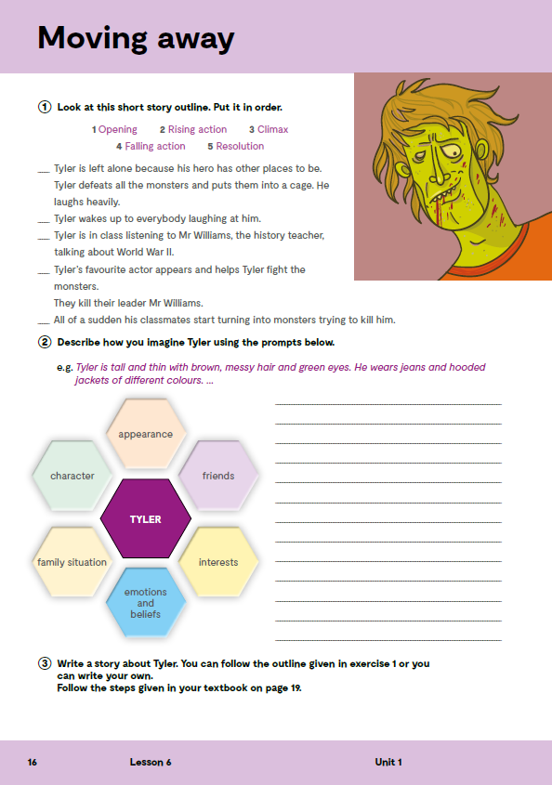
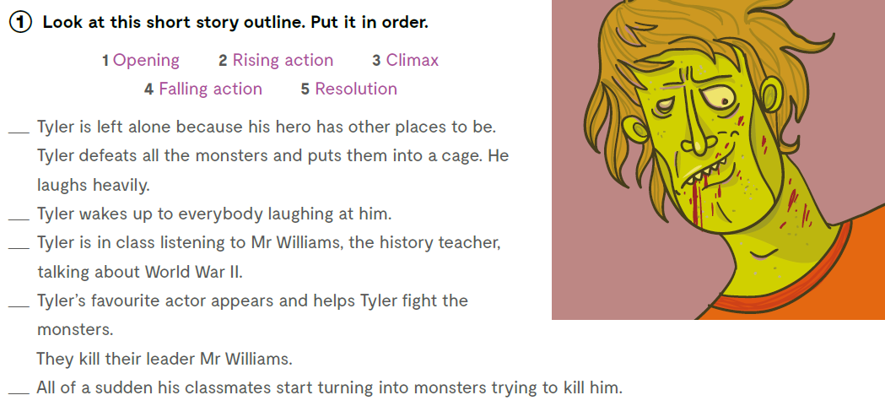
Look at this short story outline. Put it in order.
opening uvod
rising action početak radnje
climax vrhunac radnje
falling action završetak radnje
resolution rasplet
4
5
1
3
2

Slide 6

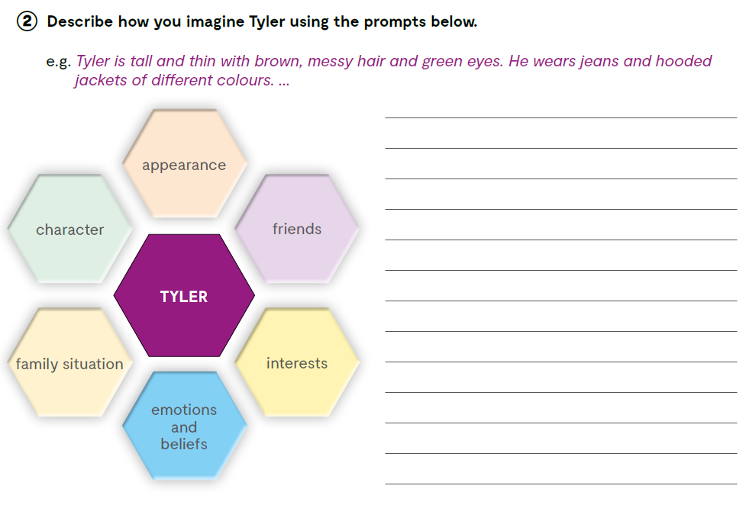
Describe how you imagine Tyler using the prompts below.

Slide 7
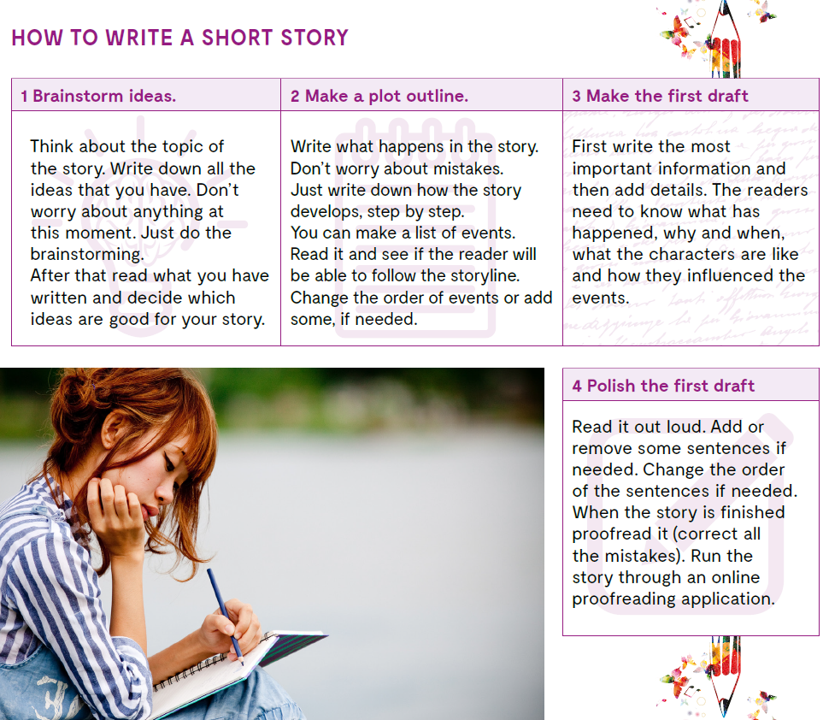
Go back to your book, page 19.
Read these tips on HOW TO WRITE A SHORT STORY because you will need them for the next task.
1 BRAINSTORM IDEAS
2 MAKE A PLOT OUTLINE
3 MAKE THE FIRST DRAFT
4 POLISH THE FIRST DRAFT

Slide 8
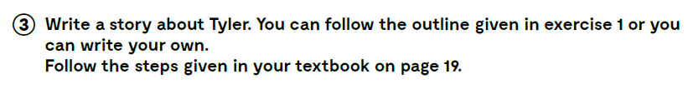
Write a story about Tyler. You can follow the outline given in exercise 1 or you can write your own.
Follow the steps given in your textbook on page 19.

Slide 9
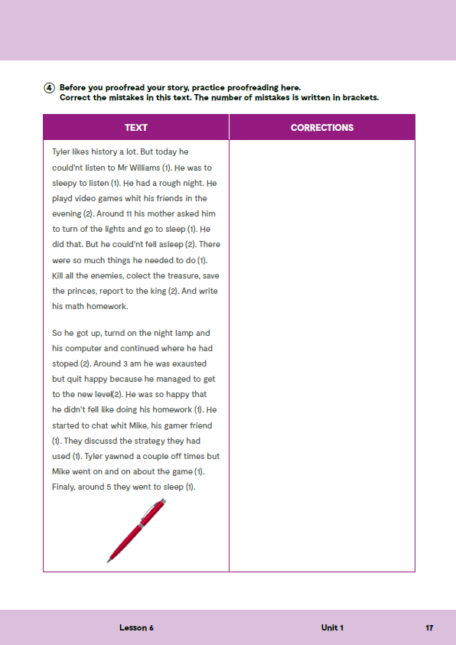
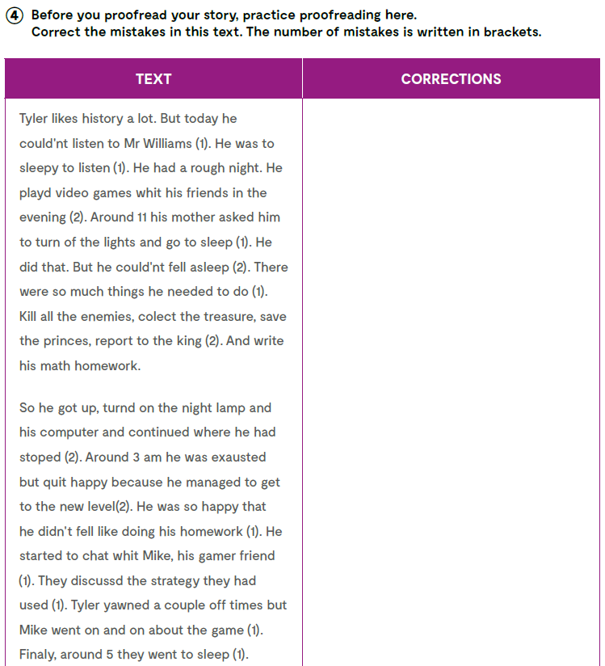
On the next page, page 17.
Before you proofread your story, practice proofreading here. Correct the mistakes in this text. The number of mistakes is written in brackets.
couldn’t
to
with
played
off
couldn’t fall
many
collect
princess
turned
stopped
exhausted
quite
feel
Check what you have learnt:
https://learningapps.org/watch?v=pngkcqf2k21
https://www.bookwidgets.com/play/TB6HWTF
with
discussed
of

